Slide 1

Flavour Hub
Deliciousness at your doorstep
Presented by : PRATIKSHYA SINGH
MCA 4TH SEMESTER
Regestration No: 2305260016
Rourkela Institute Of Management Studies

Slide 2

Index
Introduction
Objectives
Problem Statement
Solution Overview
Technology Stack
Architecture
Features
Security
Database
Performance and Scalability
Business Impact
Future Enhancements
Conclusion

Slide 3
Introduction
Flavour Hub is a cloud kitchen-based e-commerce platform designed to streamline online food ordering and kitchen operations. It offers a seamless interface for customers to browse menus, place orders, and track deliveries, while providing an admin dashboard for efficient order and product management.
Built using Spring Boot, HTML, CSS, JavaScript, and MySQL, Flavour Hub ensures scalability, security, and performance. The platform aims to enhance customer experience, reduce manual errors, and improve the efficiency of cloud kitchens.

Slide 4

objectives
Enhance Customer Experience: Provide a seamless and user-friendly online food ordering platform.
Streamline Kitchen Operations: Simplify order management and reduce manual errors.
Ensure Security: Protect customer data with Spring Boot Security and secure authentication.
Achieve Scalability: Handle growing customer demands efficiently with a robust backend.
Optimize Performance: Ensure fast and reliable order processing and real-time updates.

Slide 5
Problem Statements
Inefficient Order Management: Manual order handling leads to errors and delays.
Lack of Online Presence: Cloud kitchens struggle to reach more customers without a digital platform.
Data Inconsistency: Managing customer and order data manually increases the risk of inaccuracies.
Limited Scalability: Traditional systems cannot efficiently handle growing order volumes.

Slide 6
Solution OVERVIEW
Flavour Hub offers a cloud kitchen e-commerce platform that addresses the challenges of online food ordering by:
Seamless Customer Experience: Easy product browsing, cart management, and real-time order tracking.
Efficient Admin Dashboard: Manage products, categories, and orders with ease.

Slide 7
Solution OVERVIEW
Secure Authentication: Spring Boot Security ensures data protection and secure transactions.
Scalable Architecture: Handles increasing user traffic and order volume efficiently.

Slide 8
TECHNOLOGY STACK
Backend: Spring Boot (Java) – for business logic and APIs.
Frontend: HTML, CSS, JavaScript – for a responsive and user-friendly interface.
Database: MySQL – for storing customer, product, and order data.
Security: Spring Boot Security – for authentication and data protection.
Tools: IntelliJ IDEA, Git – for development and version control.

Slide 9
architecture
Backend Architecture
Framework: Built using Spring Boot to manage business logic and API interactions.
Layers:
Controller Layer: Handles HTTP requests and responses.
Service Layer: Contains business logic for order processing, authentication, and data management.
Repository Layer: Manages database operations using JPA/Hibernate.

Slide 10
architecture
Data Base : MySQL for storing customer, product, and order data.
CRUD operations for data management.
Security: Spring Boot Security for authentication and role-based access control.
Frontend Architecture :
Technologies: HTML for structure, CSS for styling, and JavaScript for interactivity.

Slide 11
architecture
Frontend Architecture :
API Integration:Connects with the backend to fetch and display dynamic content. Real-time updates for products, categories, and order status.
Responsive Design: Ensures compatibility across desktop, tablet, and mobile devices.
User Interface Features:Product catalog, cart management, and checkout process with dynamic content rendering.

Slide 12
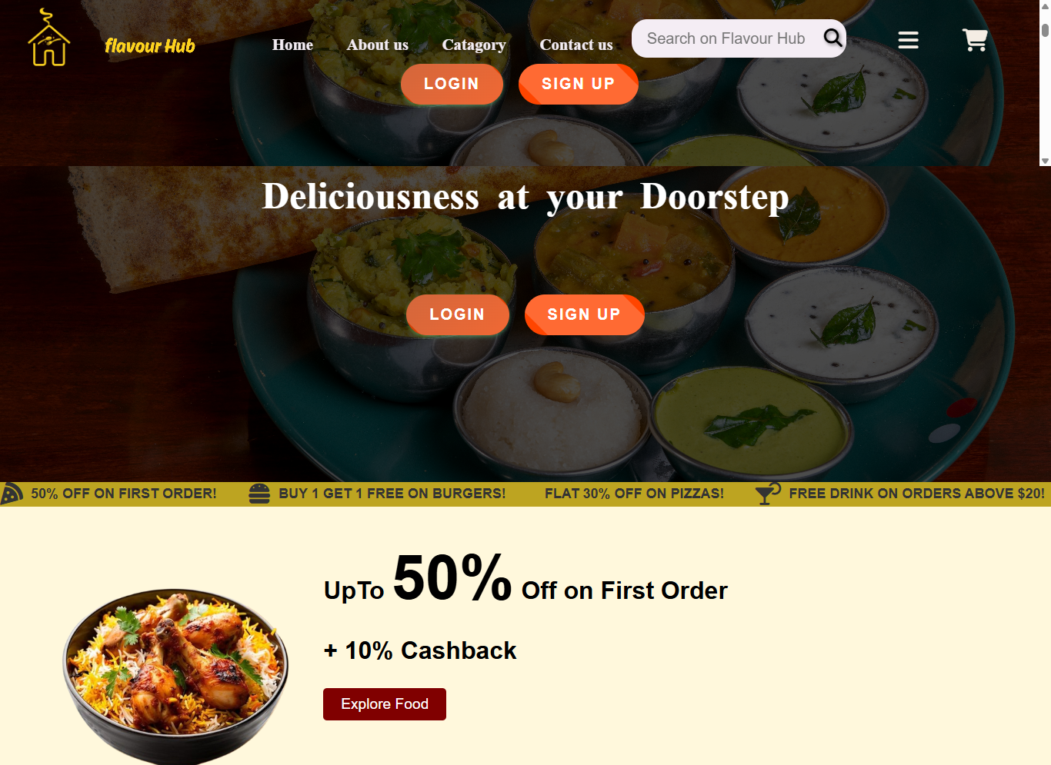
architecture
Home Page

Slide 13
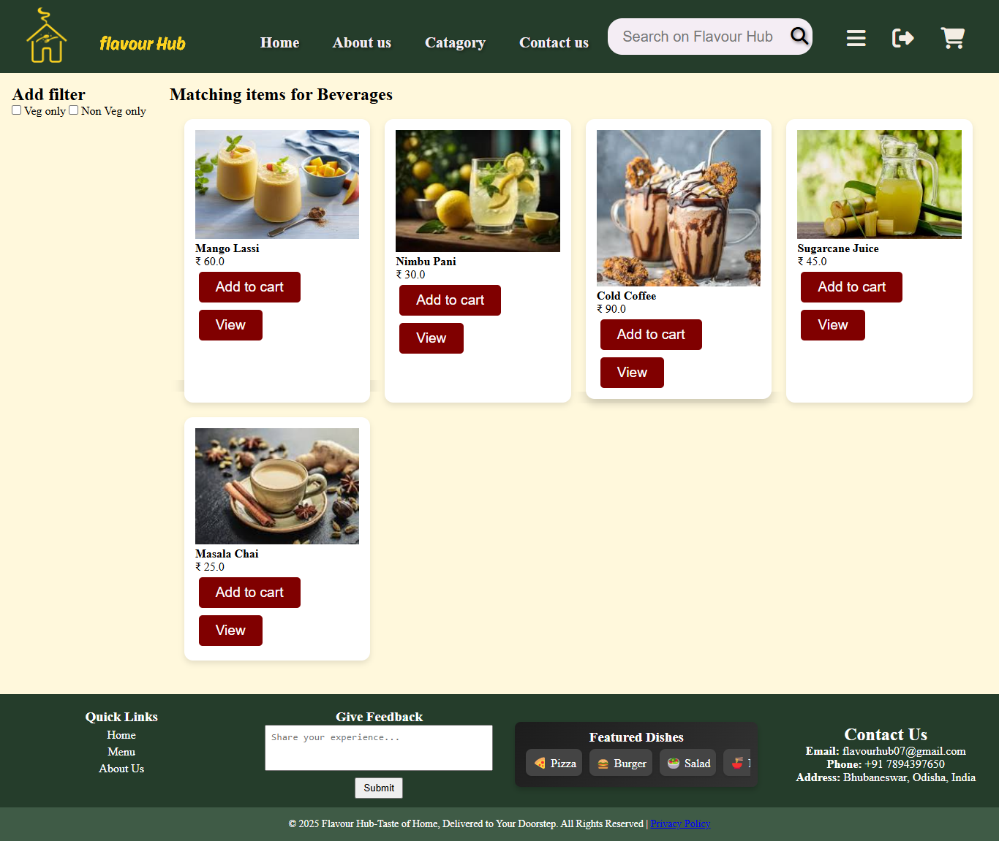
architecture
Product Listing Page (PLP)

Slide 14
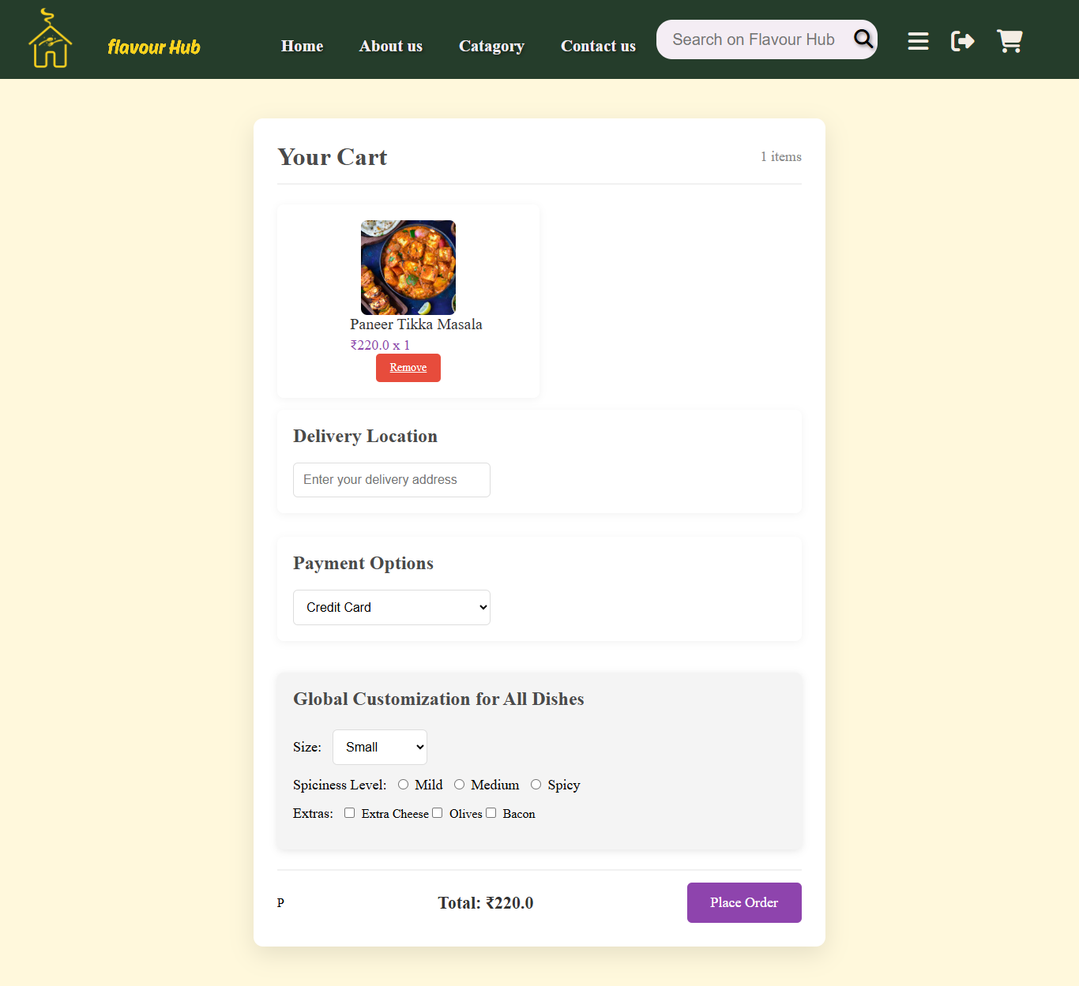
architecture
Cart Page

Slide 15
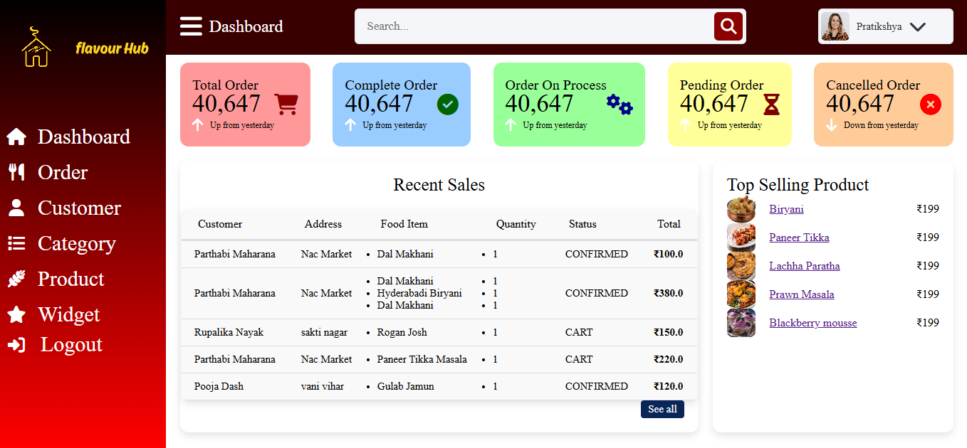
architecture
Admin Dashboard

Slide 16
FEATURES
Customer Interface:
User authentication and registration.
Product catalog with filtering and sorting.
Cart management and seamless checkout.
Admin Dashboard:
Manage products, categories, and orders.
Real-time order tracking and updates.
Security: Spring Boot Security for authentication and data protection.
Responsive Design:Optimized for desktop, tablet, and mobile devices.
Performance:Fast and reliable order processing with real-time updates.

Slide 17
FEATURES
Security: Spring Boot Security for authentication and data protection.
Responsive Design:Optimized for desktop, tablet, and mobile devices.
Performance:Fast and reliable order processing with real-time updates.

Slide 18
SECURITY
Authentication: Spring Boot Security for user authentication and role-based access control.
Data Protection : Secure handling of sensitive customer information.
Prevention of SQL injection and other vulnerabilities.
Session Management: Secure user session handling to prevent unauthorized access.
Error Handling: Graceful error messages and exception handling for a secure experience.

Slide 19
DATABASE
The Flavour Hub project uses MySQL as its relational database to efficiently manage and store data. It includes well-structured tables for users, products, categories, and orders. The User table handles authentication details, while the Product and Category tables store food items and their classifications. The Order table tracks customer purchases and order statuses. The application uses CRUD operations (Create, Read, Update, Delete) for data manipulation, ensuring smooth and consistent data management. Entity relationships and foreign key constraints are implemented to maintain data integrity and accuracy.

Slide 20
Performance and scalability
Performance:
Optimized with efficient database queries and indexing for faster data retrieval.
Caching mechanisms to reduce server load and improve response times.
Real-time order updates for a seamless user experience.

Slide 21
Performance and scalability
Scalability:
Designed to handle growing user traffic and order volume.
Asynchronous processing for efficient background operations.
Flexible architecture to support future feature expansions.

Slide 22
Business impact
The Flavour Hub project significantly enhances the efficiency and profitability of cloud kitchens by streamlining order management and reducing manual errors. By offering a seamless online ordering platform, it improves customer experience through faster service, real-time tracking, and secure transactions. The platform also helps cloud kitchens expand their customer reach by establishing a strong online presence, leading to increased sales and revenue growth. With its scalable architecture, Flavour Hub can easily accommodate growing user traffic and adapt to future business expansions, making it a valuable solution for modern cloud kitchens.

Slide 23
Future enhancement
Payment Gateway Integration: Add support for online payments via Stripe or PayPal.
Real-time Order Tracking: Implement GPS tracking for live order status updates.
AI-Powered Recommendations: Use machine learning to suggest personalized food items.

Slide 24
Future enhancement
Analytics and Reporting: Add data-driven insights to track sales and customer trends.
Mobile App Development: Expand the platform with a mobile application for wider accessibility.

Slide 25
conclusion
The Flavour Hub project effectively streamlines online food ordering and kitchen operations for cloud kitchens. With Spring Boot, MySQL, and a responsive frontend, it ensures efficiency, security, and scalability. The platform simplifies order management and enhances customer experience through real-time updates and a user-friendly interface. Its scalable architecture and potential for future enhancements make it a robust solution for long-term growth in the cloud kitchen industry.

Slide 26

Thank you

